Slide 1

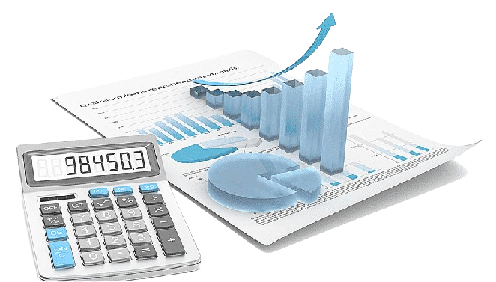
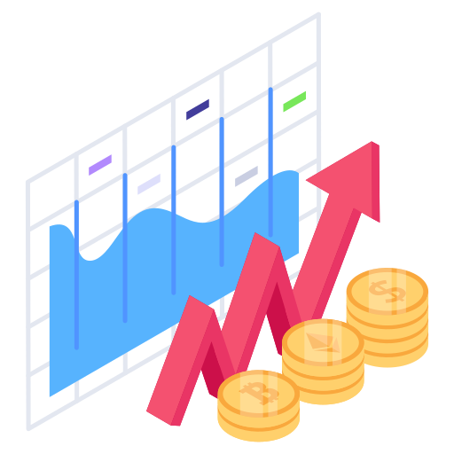
Tushar Padavi
Data Analysts

Slide 2

Introduction and Problem Statement
The goal of this presentation is to identify key metrics and factors driving competitiveness among Indian companies, ultimately providing actionable recommendations for strategic decision-making.
Problem Statement:
Without analyzing the competition, it is difficult for a business to survive. You are
tasked to analyse the competition for the management to provide better results. This
data set has information on the market capitalization of the top 500 companies in India.

Slide 3


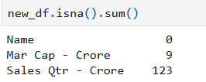


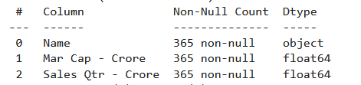
Details of Data
After Drop Null Value
3 Columns and 365 Rows
3 Columns and 488 Rows

Slide 4
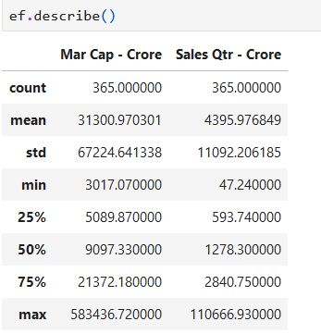
Mock – up Dashboard
These statistics present a comprehensive overview of two key variables: 'Mar Cap - Crore Sales' and 'Qtr - Crore count'.
For 'Mar Cap - Crore Sales', we have data for 365 instances. The average (mean) sales figure stands at ₹31,300.97 Crore, with a considerable standard deviation of ₹67,224.64 Crore, indicating a wide dispersion of values around the mean. The sales range from a minimum of ₹3,017.07 Crore to a maximum of ₹583,436.72 Crore. Additionally, the median sales figure, which represents the middle value when the data is ordered, is ₹9,097.33 Crore.
On the other hand, 'Qtr - Crore count' also has 365 data points. The mean count is ₹4,395.98 Crore, with a standard deviation of ₹11,092.21 Crore. The range of counts extends from a minimum of ₹47.24 Crore to a maximum of ₹110,666.93 Crore. The median count is ₹1,278.30 Crore.

Slide 5
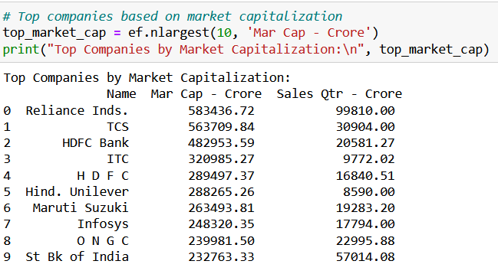
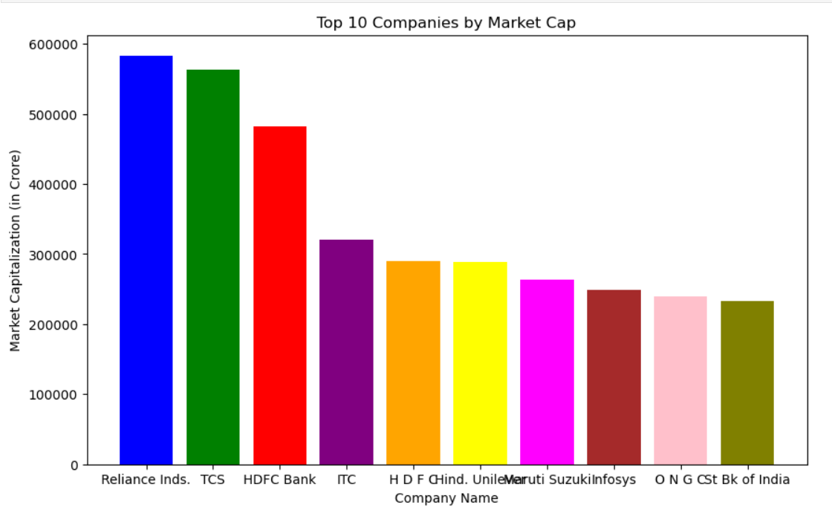
Mock – up Dashboard
The top companies based on market capitalization represent the giants of the financial world, reflecting their size, influence, and market dominance. Here's a breakdown:
Reliance Inds.: Leading the pack with a market capitalization of ₹583,436.72 Crore, Reliance Industries holds a significant position in the market, driven by its diverse business portfolio.
TCS: Following closely, Tata Consultancy Services (TCS) commands a market capitalization of ₹563,709.84 Crore, underscoring its prominence in the IT services sector and global markets.
HDFC Bank: With a market capitalization of ₹482,953.59 Crore, HDFC Bank stands as a stalwart in the banking industry, renowned for its robust financial performance and extensive customer base.
ITC: ITC holds a market capitalization of ₹320,985.27 Crore, reflecting its strong presence in various sectors including FMCG, hotels, and agri-business.
HDFC: Housing Development Finance Corporation (HDFC) boasts a market capitalization of ₹289,497.37 Crore, highlighting its leadership in the housing finance sector and financial services industry.
Hind. Unilever: With a market capitalization of ₹288,265.26 Crore, Hindustan Unilever Limited (HUL) is a powerhouse in the consumer goods sector, known for its iconic brands and consumer-centric approach.
Maruti Suzuki: Maruti Suzuki India Limited holds a market capitalization of ₹263,493.81 Crore, solidifying its position as a leader in the automotive industry in India.
Infosys: Infosys Limited, with a market capitalization of ₹248,320.35 Crore, remains a key player in the IT services landscape, renowned for its technological innovations and global presence.
O N G C: Oil and Natural Gas Corporation (ONGC) has a market capitalization of ₹239,981.50 Crore, reflecting its significant role in the energy sector and contributions to India's energy security.
St Bk of India: State Bank of India (SBI) rounds up the top 10 with a market capitalization of ₹232,763.33 Crore, showcasing its status as India's largest public sector bank and a cornerstone of the banking industry.

Slide 6
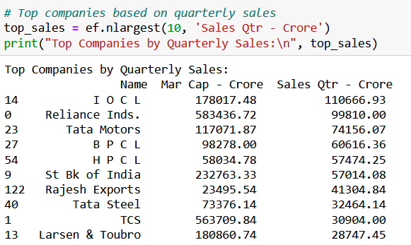
Mock – up Dashboard
The top companies based on quarterly sales represent leaders in their respective industries. These rankings are determined by the magnitude of sales figures reported during a specific quarter.
IOCL stands at the forefront with quarterly sales reaching ₹110,666.93 Crore, demonstrating its significant market presence and robust performance.
Reliance Inds. follows closely with quarterly sales of ₹99,810.00 Crore, showcasing its substantial contribution to the market.
Tata Motors secures the third position, reporting quarterly sales of ₹74,156.07 Crore, reflecting its strong performance in the automotive sector.
BPCL and HPCL occupy the fourth and fifth positions, respectively, with notable quarterly sales figures of ₹60,616.36 Crore and ₹57,474.25 Crore, underscoring their significance in the energy sector.
St Bk of India emerges as a major player in the banking industry, ranking sixth with quarterly sales of ₹57,014.08 Crore.
Rajesh Exports, Tata Steel, TCS, and Larsen & Toubro complete the top 10 list, showcasing their strong market presence across various sectors.

Slide 7
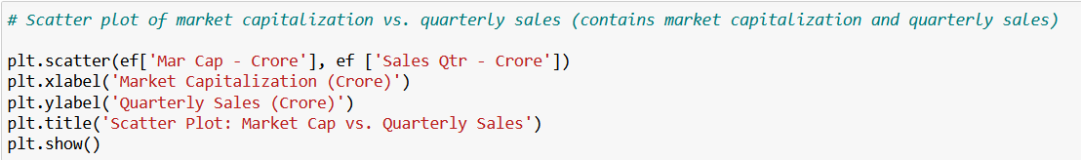
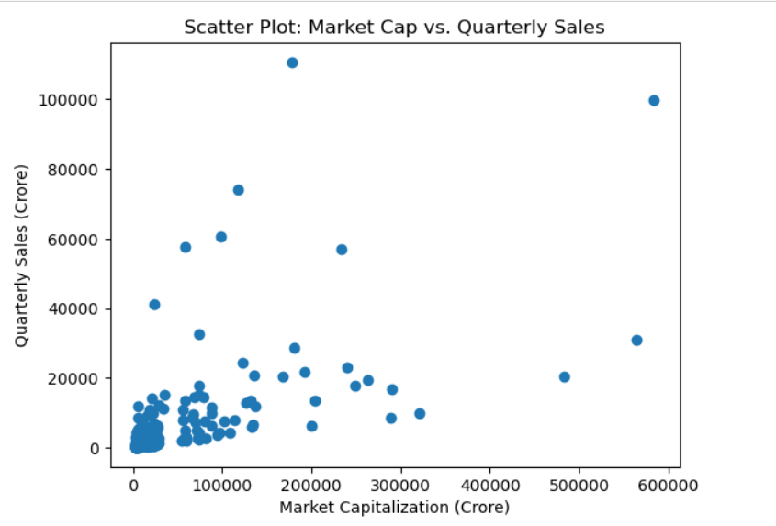
Mock – up Dashboard
If we observe a general trend where points cluster towards the upper-right corner of the plot, it suggests a positive correlation between market capitalization and quarterly sales."
Conversely, if the points appear scattered with no clear pattern, it indicates a weaker or no correlation between the two variables
Identifying any outliers or clusters of points can help us pinpoint companies that exhibit exceptional performance in terms of market capitalization and quarterly sales.
Analyzing the position of points relative to others can provide insights into the relative competitiveness and market positioning of different companies.
13/05/2024

Slide 8
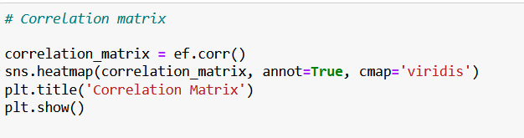
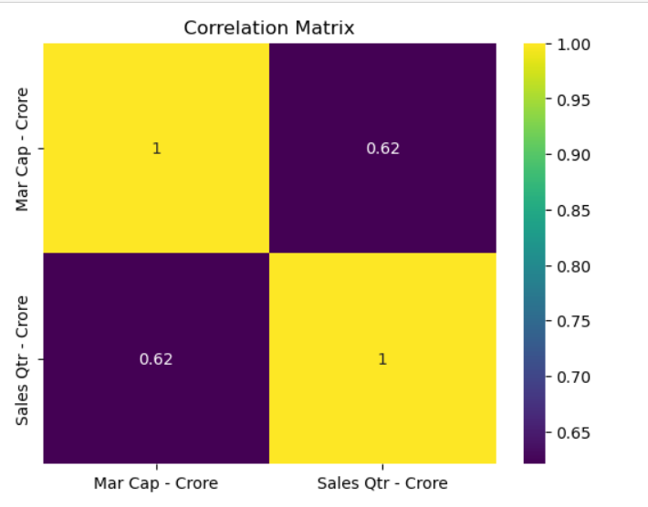
Mock – up Dashboard
Correlation coefficients range from -1 to 1, where -1 indicates a perfect negative correlation, 0 indicates no correlation, and 1 indicates a perfect positive correlation.
The color intensity in each cell of the heatmap signifies the strength of the correlation: darker shades represent stronger correlations, while lighter shades indicate weaker correlations.
Positive correlations are represented by shades of green, while negative correlations are depicted in shades of purple
13/05/2024

Slide 9
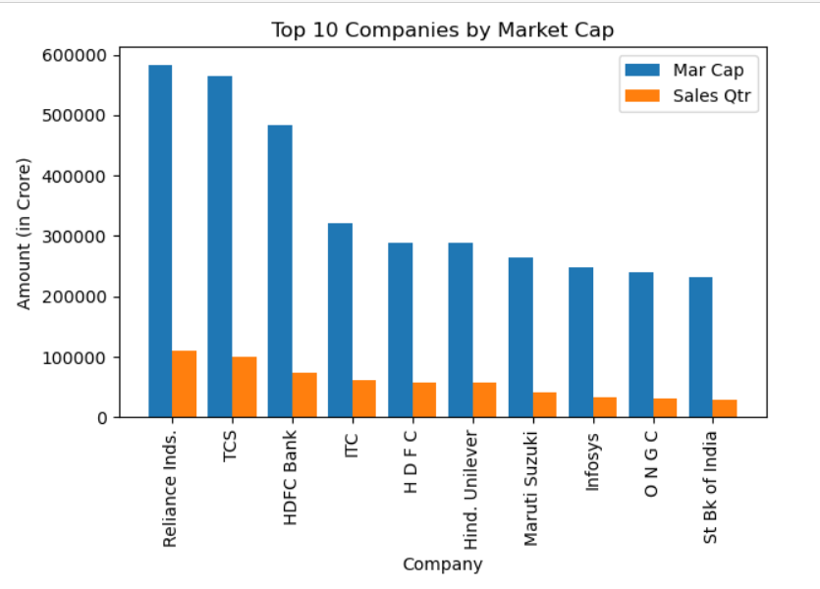
Mock – up Dashboard
The bar plot illustrates the market capitalization and quarterly sales of the top 10 companies. Each bar represents a company, with the x-axis showing the company names and the y-axis indicating the amounts in crore.
The blue bars represent the market capitalization (Mar Cap) of each company. The height of each blue bar corresponds to the market capitalization value.
The orange bars represent the quarterly sales (Sales Qtr) of each company. Similarly, the height of each orange bar corresponds to the quarterly sales value.

Slide 10
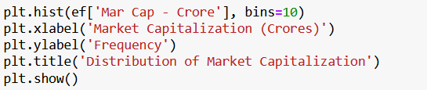
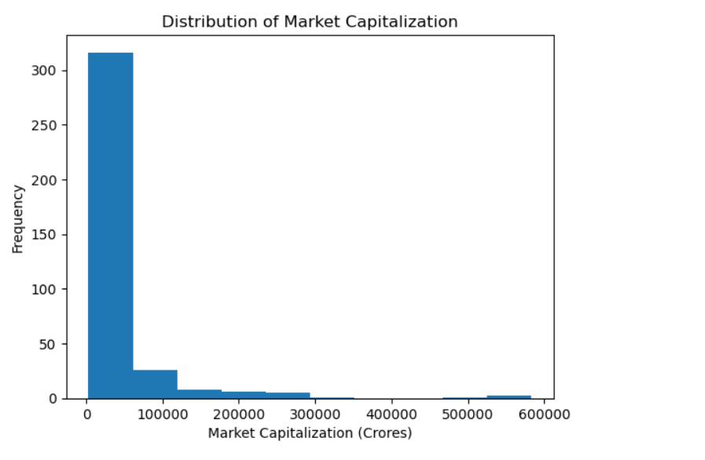
Mock – up Dashboard
The insights gained from this histogram can inform strategic decision-making processes such as investment strategies, market positioning, and risk assessment.
It helps us understand the market dynamics and the relative positions of companies within the market
13/05/2024

Slide 11
Thank you

